Slide 1
The client as teacher: Formation of students by simulated clients Clark D. Cunningham W. Lee Burge Professor of Law & Ethics Director, National Institute for Teaching Ethics & Professionalism Georgia State University College of Law Atlanta, Georgia U.S.A. cdcunningham@gsu.edu www.clarkcunningham.org www.niftep.org

Slide 2
My home page

Slide 3
Download this presentation
PPT
PDF

Slide 4
13 Clinical Law Review 1 (2006)

Slide 5
Standardized or Simulated Patients in Medical Education

Slide 6
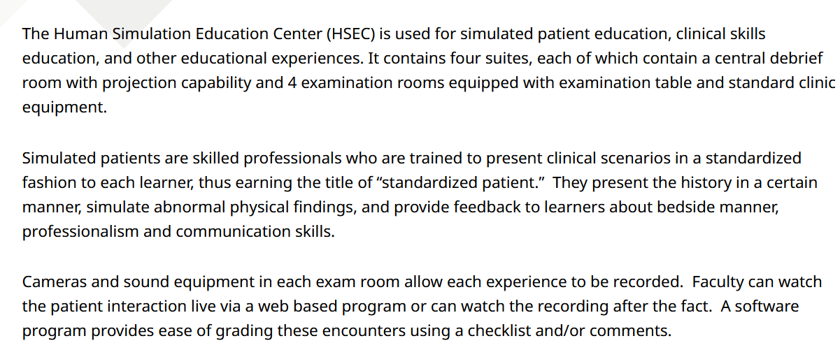

Slide 7
SCs – origins Adapted from Paul Maharg July 20 presentation
Strathclyde University, 2005. Diploma in Legal Practice
Pilot project (partners Georgia State University College of Law, Dundee University Medical Faculty)
Used model from medical profession of Simulated Patients (SPs), non-lawyers were trained to be Simulated Clients (SCs)
SCs evaluated aspects of the interview that can be assessed by non-lawyers (e.g. “I understood what the lawyer was saying”)
Study proved SCs assessed important aspects of client interviewing with better validity and reliability than law teachers
Made what client thinks important the most salient for the student: the interview grade is given by the client
This changed how the Diploma course enabled students, lawyer trainees and lawyers to learn interviewing & client-facing ethical behaviour
Paul Maharg | CC BY-NC-ND 2.5 CANADA

Slide 8
University of Strathclyde Law School (Glasgow, Scotland) Diploma in Legal Practice | WS (Writers to the Signet Society) (Edinburgh, Scotland) Signet Accreditation
State of New Hampshire (USA) Alternative to the Bar Exam (Webster Scholars Honors Program Univ of New Hampshire Law School) | The Australian National University College of Law (Canberra, ACT, AUS)
Northumbria University Law School (Newcastle, England) | Kwansei Gakuin University Law School (Osaka, Japan)
Hong Kong University Faculty of Law (Hong Kong) | The Chinese University of Hong Kong (Hong Kong)
Nottingham Trent University Law School (Nottingham, England) | Newcastle University Law School (Newcastle, England)
Osgoode Hall Law School/ OPD (Toronto, Ontario, Canada) | University of Windsor Faculty of Law (Windsor, ON, CA)
Flinders Law School (Adelaide, S. Australia, AUS) | Solicitors Regulation Authority (England & Wales) Solicitors Qualifying Examination Pt2
Canadian Centre for Professional Legal Education (CPLED, Provinces of Alberta, Manitoba, Nova Scotia, Saskatchewan) | Law Society of Ireland (Dublin, Ireland)
National Centre for Skills in Social Care (London, England) | AND NOW YOU?

Slide 9
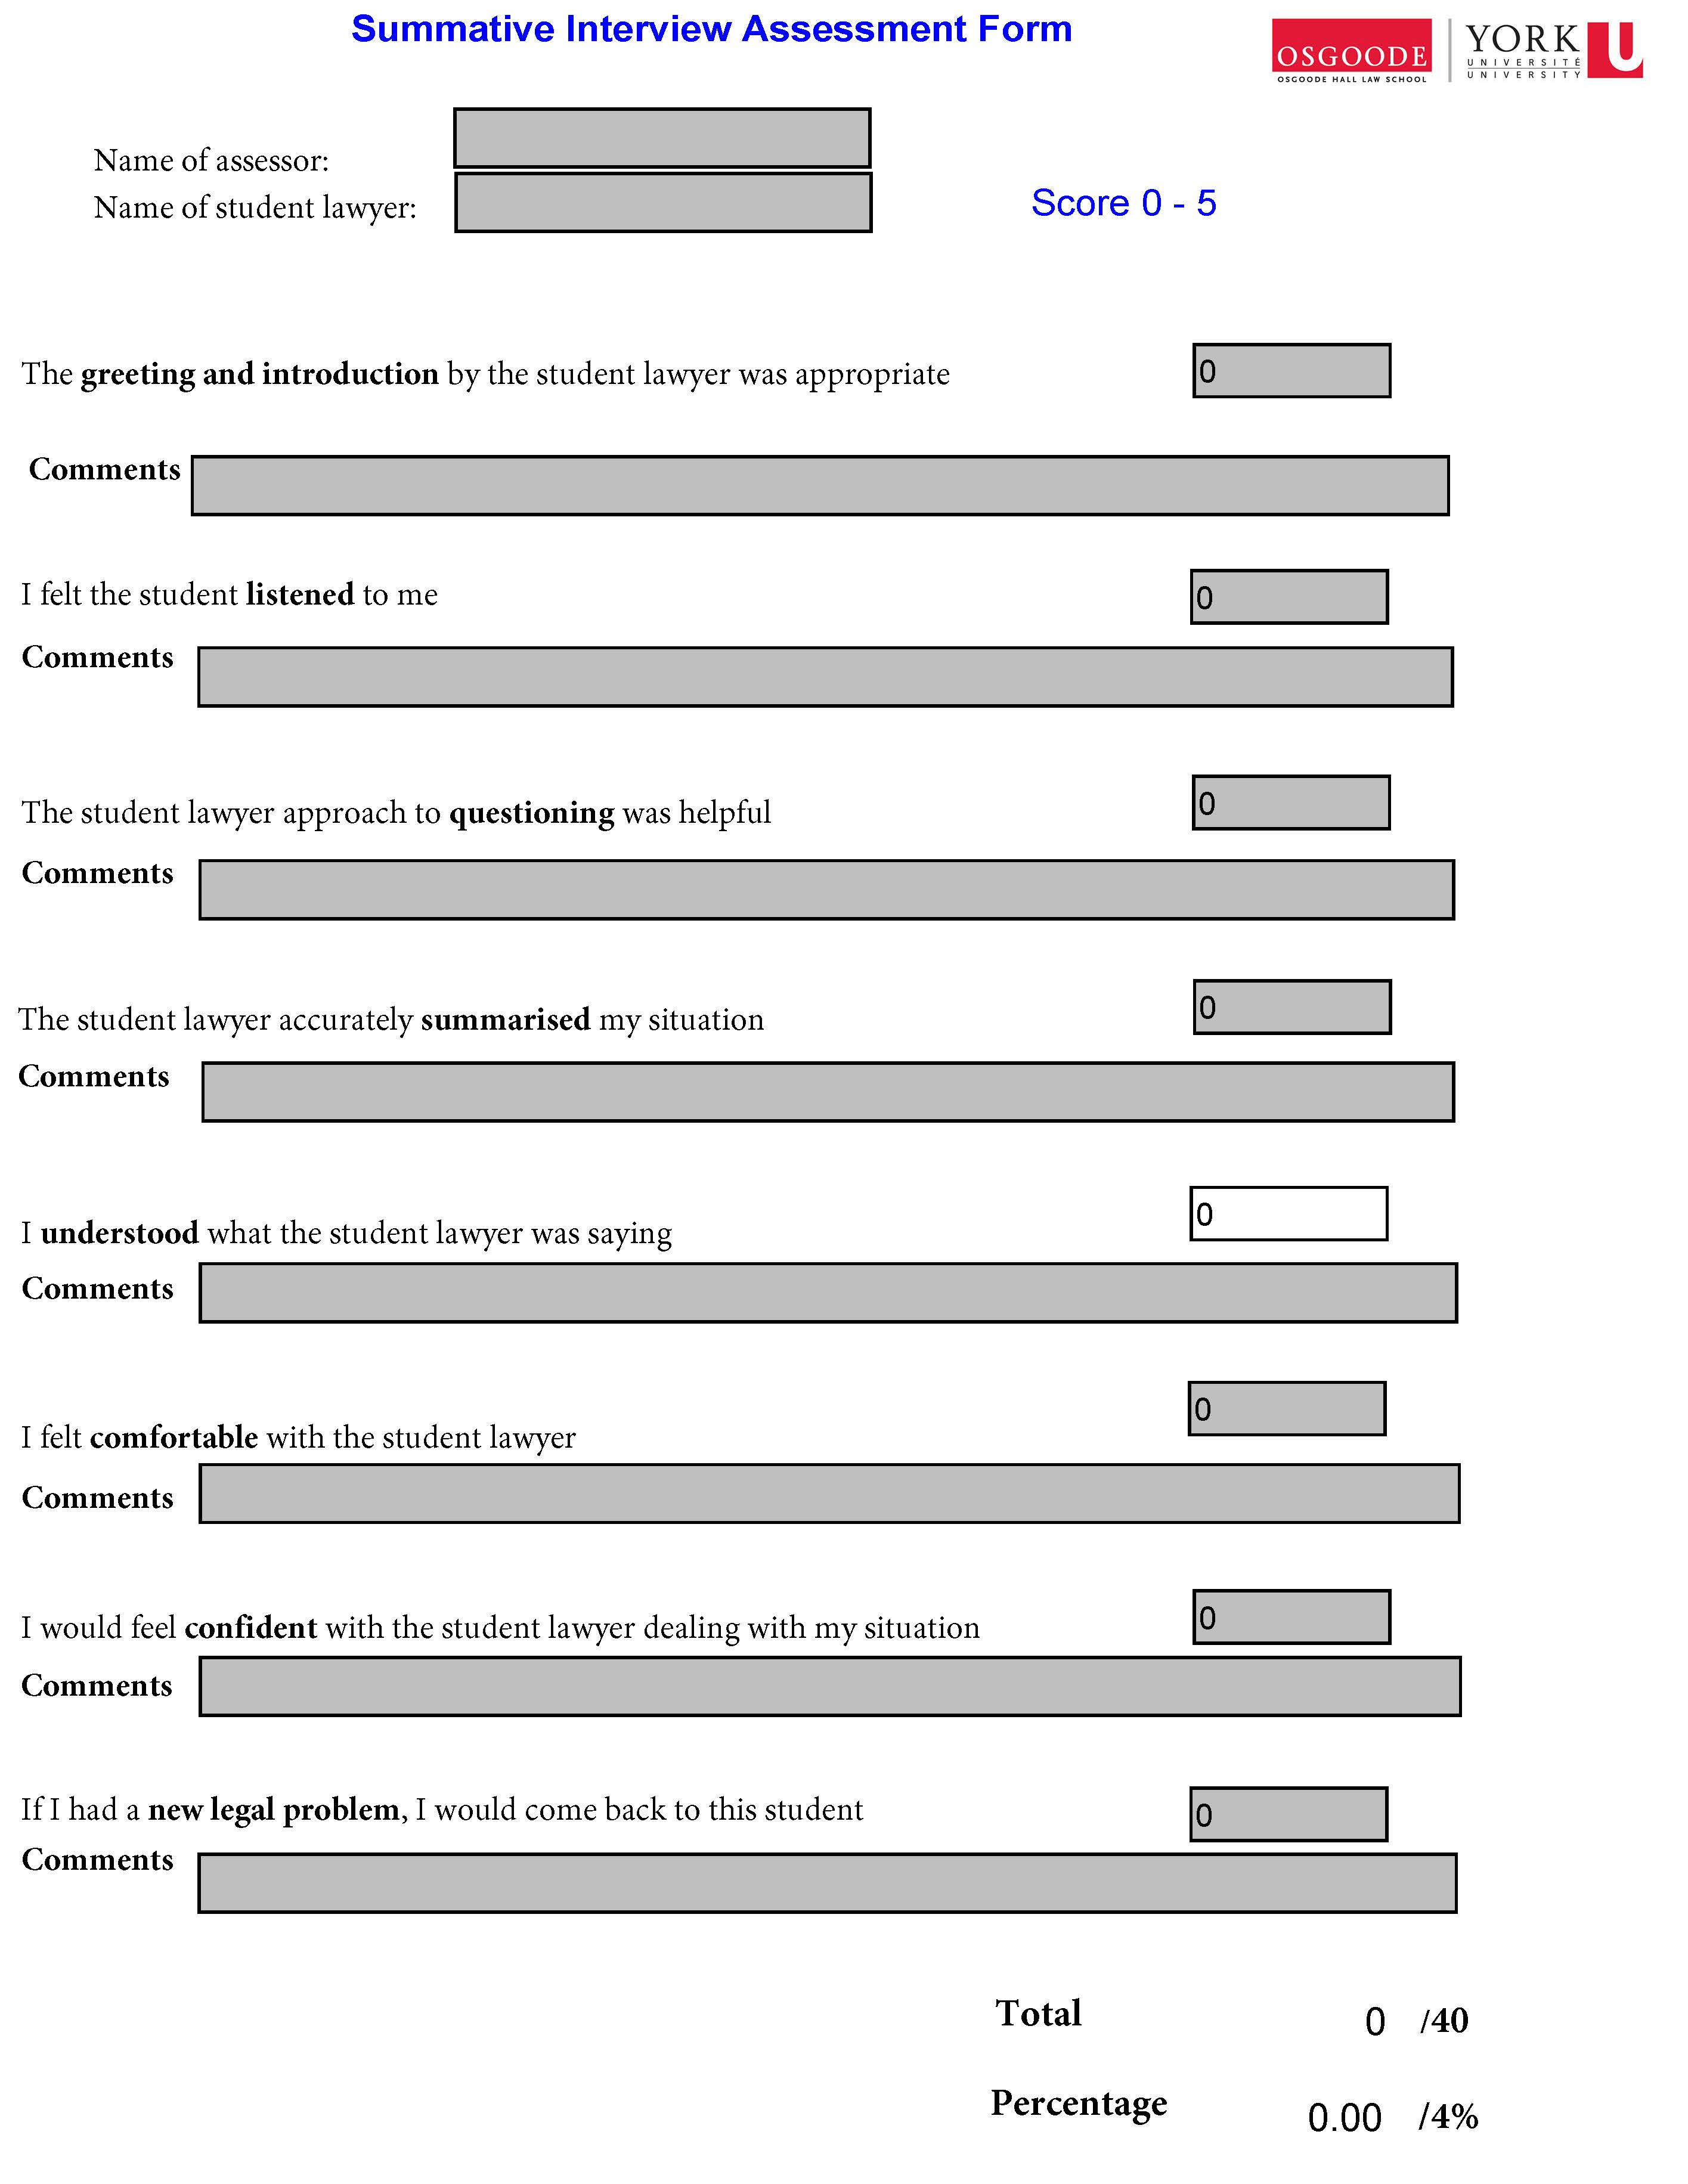

Slide 10
Matching standards to criteria - eg assessment criterion 2
2. I felt the student lawyer listened to me.
This item is designed to assess the degree to which the lawyer can listen carefully to you. These criteria focus especially on the early part of the meeting when the client should be encouraged to tell their story and concerns in their own words. This entails active listening – where it is necessary for the interview structure or the lawyer’s understanding of your narrative. The lawyer will not interrupt, cut you off, talk over you or rush you in conversation. The lawyer reacts to your responses appropriately. The lawyer may take notes where appropriate, but if the lawyer does so, the lawyer should not lose much eye contact with you. To some extent in this item we are concerned with what the lawyer does not do that facilitates the interview.

Slide 11
I felt the student lawyer listened to me
1 | 2 | 3 | 4 | 5
Lawyer prevents you from talking by interrupting, cutting off, talking over, rushing you. Takes over the conversation prematurely as if the lawyer already knows all the answers. | Lawyer limits your opportunity to talk by interrupting, cutting you off, etc. You are allowed to answer specific questions but are not allowed to expand on topics. | Lawyer rarely interrupts or cuts off or rushes you. The lawyer reacts to your responses appropriately in order to allow you to tell your story. More interested in notes taken than in eye-contact with you. | The lawyer is clearly listening closely to you. If the lawyer interrupts, it is only to assist you in telling the story more effectively. Lawyer provides opportunities for you to lead the discussion where appropriate. Good eye contact and non-verbal clues. | The lawyer is an excellent listener and speaks only when it is clearly helpful to your telling your story. Lawyer uses silence and other non-verbal facilitators to give you an opportunity to expand. Excellent eye contact and non-verbal cues.

Slide 12
1 | 2 | 3 | 4 | 5
Lawyer prevents you from talking by interrupting, cutting off, talking over, rushing you. Takes over the conversation prematurely as if the lawyer already knows all the answers. | Lawyer limits your opportunity to talk by interrupting, cutting you off, etc. You are allowed to answer specific questions but are not allowed to expand on topics. | Lawyer rarely interrupts or cuts off or rushes you. The lawyer reacts to your responses appropriately in order to allow you to tell your story. More interested in notes taken than in eye-contact with you. | The lawyer is clearly listening closely to you. If the lawyer interrupts, it is only to assist you in telling the story more effectively. Lawyer provides opportunities for you to lead the discussion where appropriate. Good eye contact and non-verbal clues. | The lawyer is an excellent listener and speaks only when it is clearly helpful to your telling your story. Lawyer uses silence and other non-verbal facilitators to give you an opportunity to expand. Excellent eye contact and non-verbal cues.

Slide 13
Sim Client Assessment Part B
The client also completes a checklist of facts the lawyer should have learned during the meeting.

Slide 14
In the original Scotland pilot and many later uses of simulated clients there is also a 3rd assessment component: a note to file graded by a lawyer

Slide 15
University of Strathclyde Law School (Glasgow, Scotland) Diploma in Legal Practice | WS (Writers to the Signet Society) (Edinburgh, Scotland) Signet Accreditation
State of New Hampshire (USA) Alternative to the Bar Exam (Webster Scholars Honors Program Univ of New Hampshire Law School) | The Australian National University College of Law (Canberra, ACT, AUS)
Northumbria University Law School (Newcastle, England) | Kwansei Gakuin University Law School (Osaka, Japan)
Hong Kong University Faculty of Law (Hong Kong) | The Chinese University of Hong Kong (Hong Kong)
Nottingham Trent University Law School (Nottingham, England) | Newcastle University Law School (Newcastle, England)
Osgoode Hall Law School/ OPD (Toronto, Ontario, Canada) | University of Windsor Faculty of Law (Windsor, ON, CA)
Flinders Law School (Adelaide, S. Australia, AUS) | Solicitors Regulation Authority (England & Wales) Solicitors Qualifying Examination Pt2
Canadian Centre for Professional Legal Education (CPLED, Provinces of Alberta, Manitoba, Nova Scotia, Saskatchewan) | Law Society of Ireland (Dublin, Ireland)
National Centre for Skills in Social Care (London, England)

Slide 16
Alternative bar exam in State of New Hampshire (USA)
The Daniel Webster Scholar Honors Program is a program of the University of New Hampshire School of Law.
It is designed to prepare law school graduates for practice through "practice courses" and evaluations designed to develop and test fundamental skills of legal practice, including communication, negotiation, organization, work management and legal ethics.
Students in the Daniel Webster Scholar Honors Program are required to undergo evaluations periodically throughout the two-year program, and before graduating, are required to undergo a two-day assessment process, consisting of interviews, testing and simulations.
Supreme Court Rule 42(XII) makes graduates of the Daniel Webster Scholar Honors Program eligible for admission to the New Hampshire bar upon completion of the program without further examination

Slide 17
Ahead of the Curve: the Unique Daniel Webster Scholar Honors Program New Hampshire Bar Association www.nhbar.org/ahead-of-the-curve-a-150-year-retrospective-on-the-unique-daniel-webster-scholar-honors-program/
“New Hampshire is full of history and firsts in the nation
One of the most unique and recent firsts was the implementation of the UNH Franklin Pierce School of Law’s (UNH Law) Daniel Webster Scholar (DWS) Honors Program – the first bar alternative program in the nation – in 2005.
A collaborative effort of the New Hampshire Supreme Court (NHSC), the New Hampshire Bar Association (NHBA), the New Hampshire Board of Bar Examiners, and UNH Law
“It’s the first and still the only competency-based bar admission program,” DWS program director Courtney Brooks says.
“It’s the only program like it in the country that couples practice-readiness training with bar admission.
Students gain practical skills and simulations for essentially a two-year bar exam, and along the way, their skills are assessed by bar examiners.
At the end, they are admitted to the bar.”

Slide 18
Overview of the SQE2 assessment
The legal skills assessments in SQE2 are:
client interview and attendance note/legal analysis …
Professionalism and ethics will be core parts of SQE2. Questions on ethics will be pervasive throughout SQE2.
Ethical issues will not be flagged and candidates will need to identify any ethical and professional conduct issues and exercise judgment to resolve them honestly and with integrity.
Marking SQE2
The interviewing station will be marked by the assessor playing the role of the client and will be marked on skills only. The attendance note and all other stations will be marked by a solicitor who will assess candidates on both skills and application of law.

Slide 19
The Canadian Centre for Professional Legal Education (CPLED) is a non-profit organization that provides the training needed before being called to the Bars of Alberta, Manitoba, Nova Scotia and Saskatchewan.
Before becoming a lawyer, students must complete
their articling requirement
and the Bar admission program, the Practice Readiness Education Program (PREP).

Slide 20
Practice Readiness Education Program (PREP)
Simulated clients are used throughout the 4 phases of PREP
Phase 1: Foundation Modules. Students watch real lawyers interview simulated clients (good/bad performances) and are shown excerpts of the sim client feedback to the good and poor performances
Phase 2: Foundation Workshops: Students are introduced to Assessment Criteria / Rubrics
Phase 3:
Virtual Firm Business Law Client interview;
Family Law Client Interview
Phase 4: Capstone. This comprises in-person simulated client interviews and summative assessment.

Slide 21
Transitioning Simulated Client Interviews from Face-to-Face to Online
Paul Maharg & Angela Yenssen
13 European Journal of Law and Technology No. 3 (2022)

Slide 22
Brief timetable for Sim Client project development https://simclient.osgoode.yorku.ca/workshop-resources/

Slide 23
Paul Maharg Blog Resources for July 20 workshop

Slide 24
Paul Maharg Blog More detailed information on SimClients

Slide 25
Osgoode Hall Law School York University, Toronto

Slide 26
Osgoode Workshop Website

Slide 27
Download this presentation
PPT
PDF

