Slide 1
The Art of Persuasion: A Linguistic Analysis of “Persuade” and its Applicability Under 18 U.S.C. §2422(b)
Ray-Kelle Preston
Georgia State University College of Law

Slide 2
18 U.S.C. §2422(b)
Whoever, using the mail or any facility or means of interstate or foreign commerce . . . knowingly persuades, induces, entices, or coerces any individual who has not attained the age of 18 years, to engage in prostitution or any sexual activity for which any person can be charged with a criminal offense, or attempts to do so, shall be fined under this title and imprisoned not less than 10 years or for life.

Slide 3
United States v. Zupnik (2021)
Joel Zupnik was convicted of attempted enticement of a minor using the internet and sentenced to the mandatory 10 years.
On appeal, he argued the government failed to prove he had the requisite criminal intent because the minor was “willing.”
United States v. Hite (D.C. Cir. 2014): punishable only if the defendant’s interaction with an adult intermediary is aimed at transforming or overcoming the minor’s will in favor of engaging in illegal sexual activity

Slide 4
Eighth Circuit
Hite is not applicable
Zupnik believed he was communicating with a minor, not an adult intermediary
Precedent: A defendant can be found to “persuade” or ”entice” even a seemingly “willing” minor
Zupnik relentlessly messaged “Kelli” after learning her age

Slide 5
Circuit Split
Overcome the Will
No Additional Action
Fourth Circuit
Causing or arranging sexual activity, alone, does not violate the statute
Jury instructions required jury to find that Defendant made an effort to alter mental state
Sixth Circuit
Verbs refer to ”acts that seek to transform or overcome the will of the minor”
Did the defendant try to obtain the assent of the minor?
Seventh Circuit
Did not dispute that an effort to secure assent was necessary
Second Circuit
Statute imposes no requirement that an individual endeavor to transform or overcome will
Eleventh Circuit:
Upheld jury instructions allowing conviction if defendant caused the sexual act
Rejected interpretation that communication must be aimed at transforming or overcoming the minor’s will

Slide 6
A Better Way to Stop Online Predators: Encouraging A More Appealing Approach to S 2422(b), Andriy Pazuniak
Encouragement standard: where the defendant encouraged or invited the minor to take action, to support the requirement of “persuade, induce, entice, or coerce.”
Expansion of Entice: include speech that makes the illegal sexual activity more appealing to minors.

Slide 7
Linguistic Analysis

Slide 8
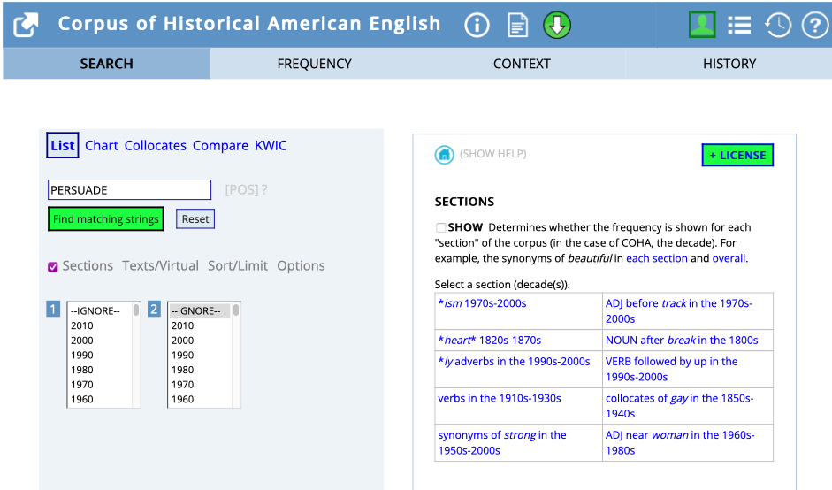
Corpus Linguistics
Corpus of Historical American English
475 million words of text from 1820s to the 2010s
Genres: Television, Movies, Plays, Magazines, Fiction, Non-Fiction

Slide 9
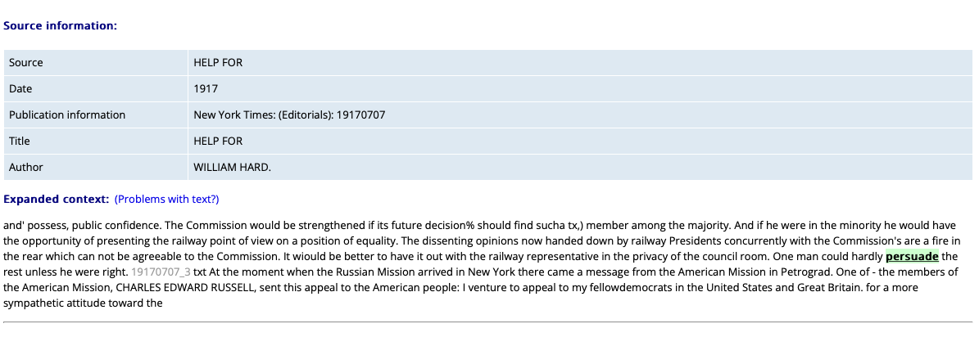

Slide 10
Analysis
Random sample of 200 texts
Examined text for three roles
Agent: one who causes the action
Patient: one who receives the action
Purpose: the endpoint of the action
Narrow Results: From 200 texts, three random samples of 20 texts
Analyzed relationship between will and persuasion
Identify initial will of the Patient
Distinguish the final resolution
Determine if purpose was realized

Slide 11
Results

Slide 12
Initial State of Willingness
Row | ID | Context | Agent | Patient | Purpose | Initial Will
1 | 14 | more secret and more successful, and the plausible secretary had contrived so well to persuade the girl that he really thought the world of her, and that a brilliant | secretary (Hon. Fitzroy Bagley) | the girl (Kate Roberts - an American heiress) | he thought the world of her | Not indicated
2 | 105 | refreshin' he wants when he gets' ome. No, you'll never persuade me as them words weren't the gentleman's own. From the way he | You (narrator) | me (farmer) | as them words weren't the gentleman's own | Indicated: words were the gentlemen's own
3 | 153 | intention of proceeding to his Manhattan home, although his sons and friends tried to persuade him to stay in his Hempstead home at least over night. Mr. Belmont declined | his sons and friends | him (Mr. Belmont) | to stay in his Hempstead home at least overnight | Indicated: intended to proceed to his Manhattan home
4 | 17 | face to the wall and hoped to die. And the minister went off to persuade Seth Curtis that his church needed his services. And that was not nearly as | minister | Seth Curtis | his church needed his services | Not indicated
5 | 82 | They seem to me, in frankness, somewhat trifling. But I can not persuade her to accept my view. She will not be happy till she has asked | I (The Cardinal) | her (Peter's housekeeper) | to accept my view (feelings of guilt are trifling) | Indicated: feelings were serious

Slide 13
Initial Willingness Results

Slide 14
Final Resolution
 | Context | Purpose | Initial Will | Final Resolution | Successful
1 | bah the President and Congress shall have our earnest co-operation, but we can not persuade ourselves, in the light of our own experience, that granting the rate-making power | Granting rate making power to the Inter-State Commerce commission will realize the good that advocates of the meaure how | Not indicated | Not persuaded | No
2 | always think of you in those impossible garnishments of my poor great-uncle, and I persuade myself that he must have been a little like you. " I trust you | he must have been a little like you | Indicated: did not think great uncles was like Mr. Vanrevel | was persuaded | Yes
3 | more secret and more successful, and the plausible secretary had contrived so well to persuade the girl that he really thought the world of her, and that a brilliant | he thought the world of her | Not indicated | it was not long before he found her in a mood to refuse him nothing | Yes
4 | Rita curled herself thankfully in Captain Jack's hammock, after trying in vain to persuade him that he was an invalid, and ought to take it himself. After | he was an invalid and ought to take it (hammock) himself | Not indicated | did not take hammock | No
5 | . " Wouldn't you? " " How could the man who owned it persuade me that he was in earnest if he said he loved me? How could | he was in earnest (to rebuild a great house) | Indicated: would not rebuild a great house | Not applicable | No

Slide 15
Was Persuasion Successful?

Slide 16
Analysis Results
 | Successful | Unsuccessful | N/A
Initial Will | 8 | 13 | 1
No Initial Will | 16 | 7 | 2
Notes:
Count for total sample

Slide 17
Conclusion
The results indicate the existence of initial will does not have a significant impact on the act of persuasion.
Even when the will was not indicated, the analysis of the full text was able to determine whether the purpose was realized and if the persuasion was successful.
Zupnik
Patient’s (Kelli) initial will is not relevant to the act of persuasion. One could determine Zupnik was successful in his attempt to “persuade, induce, entice, or coerce” without any knowledge of Kelli’s initial will.

Slide 18
Future Directions
All Four Verbs
This method would examine the existence of initial will of the Patient with the relationship of the final resolution of the persuasion for each verb and compare if similar patterns exist.
1990s to 2000s: When §2422(b) enacted
This process recognizes the flexibility of the human language and that words and their meanings can change over time.
Relationship between the Agent and the Patient
An employee and employer
A parent and child

